Slide 1
Microsoft Azure

Slide 2
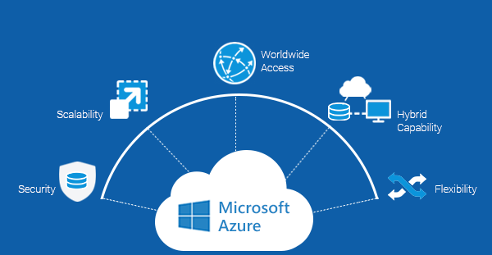
Microsoft Azure, formerly known as Windows Azure, is Microsoft's public cloud computing platform. It provides a range of cloud services, including compute, analytics, storage and networking. Users can pick and choose from these services to develop and scale new applications, or run existing applications in the public cloud. It provides services like Software as a Service (SaaS): CRM, Virtual Desktop, Email, Games. Platform as a Service (PaaS): Execution Runtime, Web Server, Database. Infrastructure as a Service (IaaS): Virtual Machines, Storage, Servers.

Slide 3
Features of azure
There are total Nine features in azure :
App service
Azure Cosmos DB
Azure Functions
Azure Kubernetes service
Azure SQL
Cognitive services
Linux Virtual machine
Windows Virtual Desktop
Windows Virtual Machines

Slide 4
App service
Azure App Service enables you to build and host web apps, mobile back ends, and RESTful APIs in the programming language of your choice without managing infrastructure. It offers auto-scaling and high availability, supports both Windows and Linux, and enables automated deployments from GitHub, Azure DevOps, or any Git repo.

Slide 5
Cosmos DB
Cosmos Database (DB) is a horizontally scalable, globally distributed, fully managed, low latency, multi-model, multi query-API database for managing data at large scale. Cosmos DB is a PaaS (Platform as a Service) offering from Microsoft Azure and is a cloud-based NoSQL database. Cosmos DB is sometimes referred to as a serverless database, and it is a highly available, highly reliable, and high throughput database. Cosmos DB is a superset of Azure Document DB and is available in all Azure regions.
With Cosmos DB you can distribute the data to any number of Azure regions, i.e., the data can be replicated to the geolocation from where your users are accessing, which helps in serving data quickly to users with low latency.
Features of Cosmos DB
Globally Distributed
With Azure Cosmos DB, your data can be replicated globally by adding Azure regions with just one click.
Linearly Scalable
Linear Scalability is the ability to handle the increased load by adding more servers to the cluster. Cosmos DB can be scaled horizontally to support hundreds of millions of transactions per second for reads and writes.
Multi-Model
Cosmos DB is a multi-model database, i.e., it can be used for storing data in Key-value Pair, Document-based, Graph-based, Column Family-based databases. Irrespective of which model you choose for your data persistence, global distribution, provisioning throughput, horizontal partitioning, and automatic indexing capabilities are the same.
Multi-API and Multi-Language Support
Microsoft has released SDKs for multiple programming languages including Java, .NET, Python, Node.js, JavaScript, etc. Cosmos DB has Multi API support, i.e., SQL API, Cosmos DB Table API, MongoDB API, Graph API, Cassandra API, and Gremlin API.
Indexes Data Automatically
Cosmos DB indexes data automatically on ALL fields in all documents by default without the need for secondary indexes, but you can still create custom indexes. Azure’s automatic indexing capability indexes every property of every record without having to define schemas and indices upfront. This capability works across every data model.
High Availability
Cosmos DB provides 99.999% availability for both reads and writes for multi-region accounts with multi-region writes.
Guaranteed Low Latency
Azure Cosmos DB always guarantees 10 milliseconds latency at the 99th percentile for reads and writes for all consistency levels

Slide 6
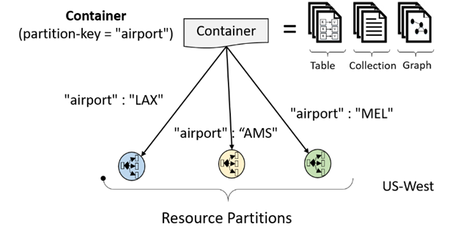
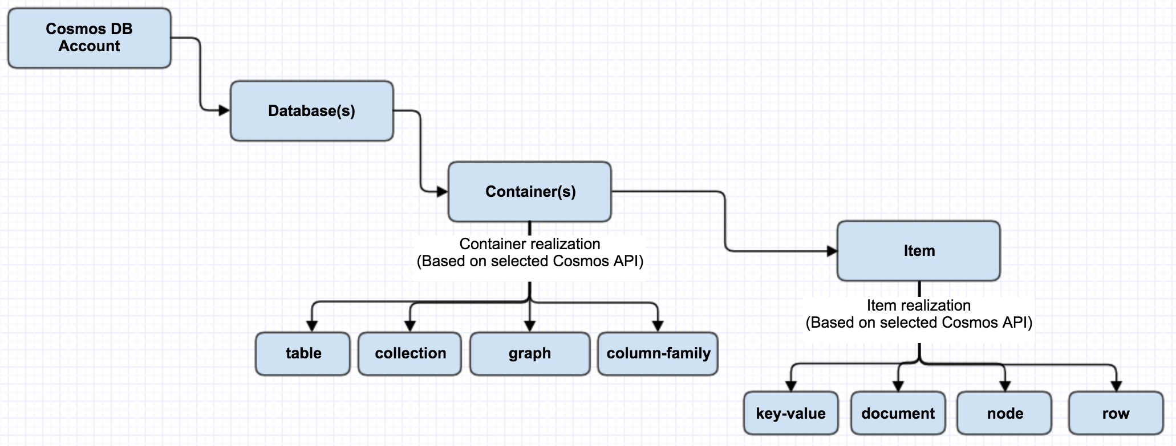
Cosmos DB

Slide 7
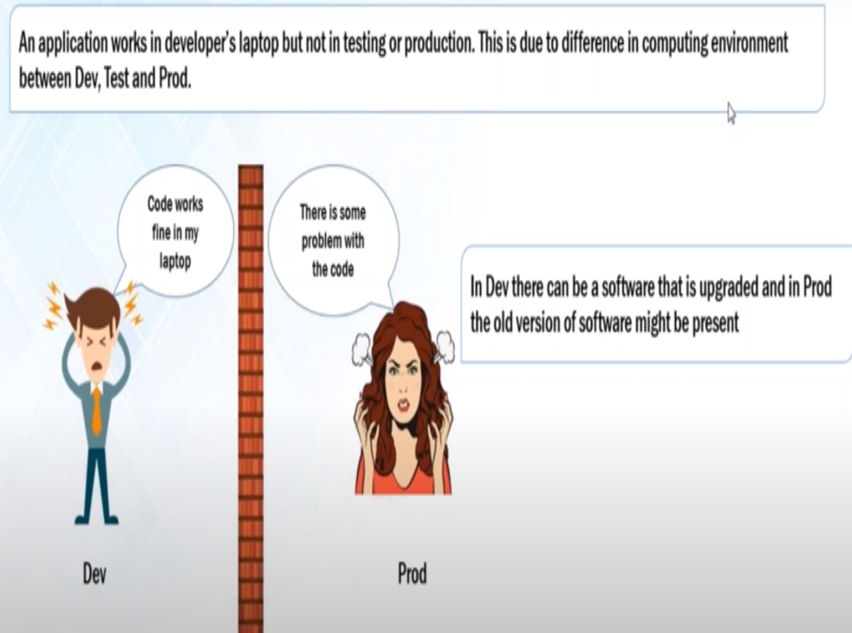
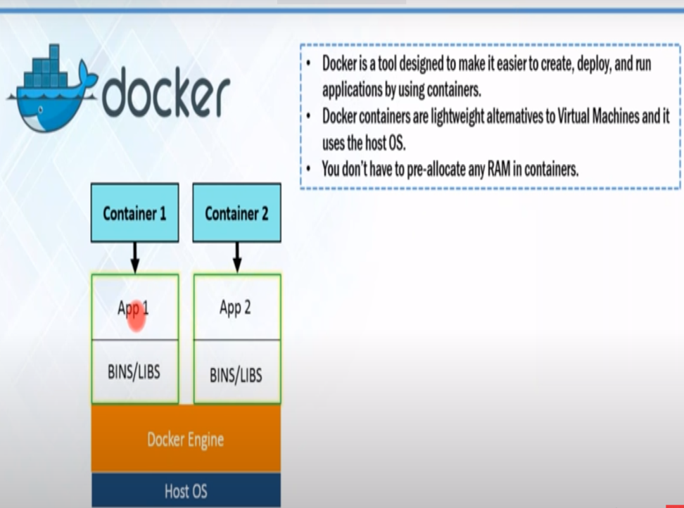
Azure Kubernetes service

Slide 8
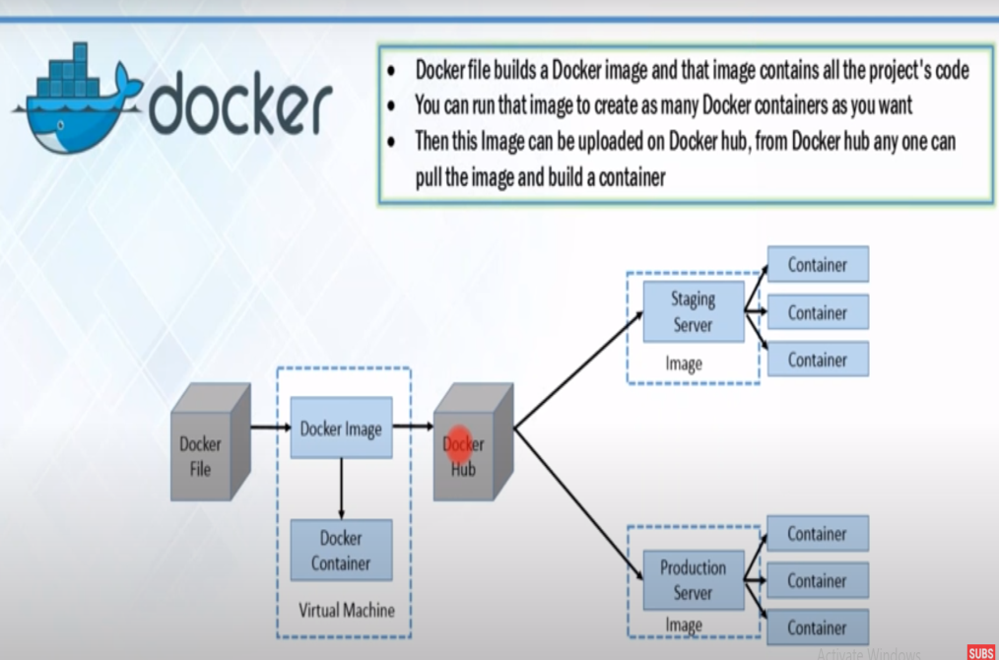
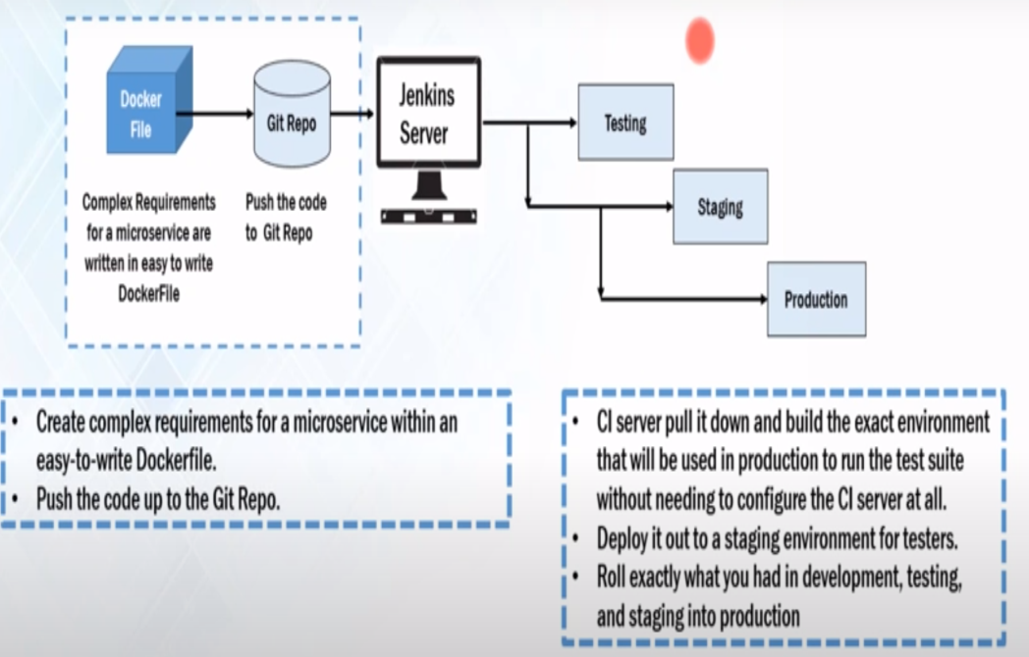
Azure Kubernetes service

Slide 9
Azure Kubernetes service
Azure Kubernetes Service (AKS) makes it simple to deploy a managed Kubernetes cluster in Azure. AKS reduces the complexity and operational overhead of managing Kubernetes by offloading much of that responsibility to Azure. As a hosted Kubernetes service, Azure handles critical tasks like health monitoring and maintenance for you. The Kubernetes masters are managed by Azure. You only manage and maintain the agent nodes. As a managed Kubernetes service, AKS is free - you only pay for the agent nodes within your clusters, not for the masters.

Slide 10
Azure SQL Database
• Built for application developers
• Lets you focus on your business application
• Accelerates your time to market
• Built-in advisors learn your app’s unique characteristics; adapts to maximize performance, reliability, and data protection
• Helps you build secure apps and connect to your database by supporting the languages and platforms that you prefer

Slide 11
Azure SQL family………..
Azure SQL is a family of managed, secure, and intelligent products that use the SQL Server database engine in the Azure cloud.
Azure SQL Database: Support modern cloud applications on an intelligent, managed database service, that includes serverless compute.
Azure SQL Managed Instance: Modernize your existing SQL Server applications at scale with an intelligent fully managed instance as a service, with almost 100% feature parity with the SQL Server database engine. Best for most migrations to the cloud.
SQL Server on Azure VMs: Lift-and-shift your SQL Server workloads with ease and maintain 100% SQL Server compatibility and operating system-level access.

Slide 12
Azure SQL Database offers the following deployment options:
As a single database- with its own set of resources managed via a logical SQL server. A single database is similar to a contained database in SQL Server.
An elastic pool- which is a collection of databases with a shared set of resources managed via a logical SQL server.

Slide 13
Purchasing models
The vCore-based purchasing model lets you choose the number of vCores, the amount of memory, and the amount and speed of storage.
The DTU-based purchasing model offers a blend of compute, memory, and I/O resources in three service tiers, to support light to heavy database workloads.
The serverless model automatically scales compute based on workload demand, and bills for the amount of compute used per second.

Slide 14
What are Azure Cognitive Services?
Azure Cognitive Services are APIs, SDKs, and services available to help developers build intelligent applications without having direct AI or data science skills or knowledge. Azure Cognitive Services enable developers to easily add cognitive features into their applications. The goal of Azure Cognitive Services is to help developers create applications that can see, hear, speak, understand, and even begin to reason.

Slide 15
Types of API provided by Azure cognitive…
Vision APIs-computer vision,ink recognition,video indexer,face.
Speech APIs-speech service,speaker recognition API,bing speech ,translator speech.
Language APIs-language understanding LUIS,QnA maker,text analytics,translator.
Search APIs-bing web search,bing news search,bing image search,bing video search etc.
Decision APIs-anamoly detectors,content moderator,personalizer.

Slide 16
Cognitive services and machine learning
Cognitive Services provides machine learning capabilities to solve general problems such as analyzing text for emotional sentiment or analyzing images to recognize objects or faces. You don't need special machine learning or data science knowledge to use these services.

Slide 17
Virtual machines in Azure
Azure Virtual Machines (VM) is one of several types of on-demand, scalable computing resources that Azure offers. Typically, you choose a VM when you need more control over the computing environment than the other choices offer. This article gives you information about what you should consider before you create a VM, how you create it, and how you manage it.
Virtual machines in Azure-linux virtual machine and windows virtual machine.

Slide 18
Azure virtual machines can be used in various ways.
Development and test – Azure VMs offer a quick and easy way to create a computer with specific configurations required to code and test an application.
Applications in the cloud – Because demand for your application can fluctuate, it might make economic sense to run it on a VM in Azure. You pay for extra VMs when you need them and shut them down when you don’t.
Extended datacenter – Virtual machines in an Azure virtual network can easily be connected to your organization’s network.

Slide 19
What is Windows Virtual Desktop?
Windows Virtual Desktop is a desktop and app virtualization service that runs on the cloud.

Slide 20
Here's what you can do when you run Windows Virtual Desktop on Azure:
Set up a multi-session Windows 10 deployment that delivers a full Windows 10 with scalability
Virtualize Office 365 ProPlus and optimize it to run in multi-user virtual scenarios
Provide Windows 7 virtual desktops with free Extended Security Updates
Bring your existing Remote Desktop Services (RDS) and Windows Server desktops and apps to any computer
Virtualize both desktops and apps
Manage Windows 10, Windows Server, and Windows 7 desktops and apps with a unified management experience

Slide 21
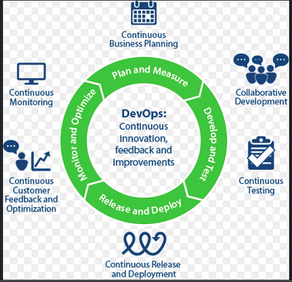
What is DevOps?
“Devops is the union of people, process and products where one can plan and measure,release and deploy,develop and test.”

Slide 22
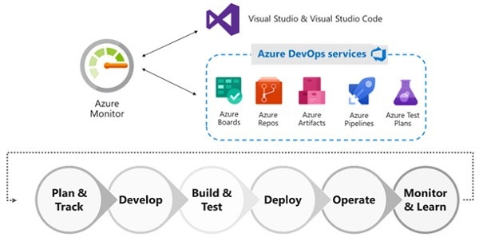
Azure for Devops
“Azure for devops provides SaaS platform from the microsoft that provides the end-to-end DevOps tools for the developing and deploying of software.”

Slide 23
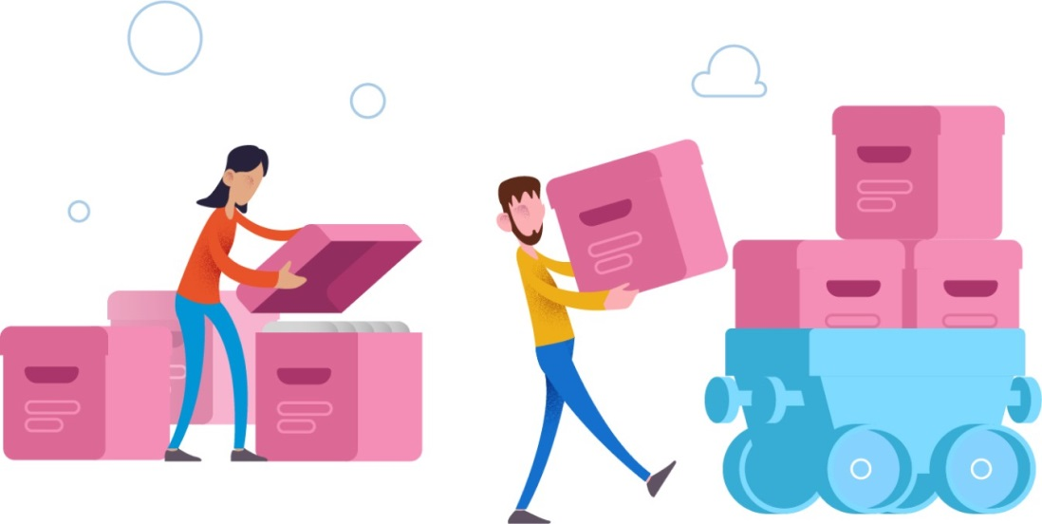
Azure Artifacts
“An Azure artifacts allow one to create, host and share the packages and code among the teams.”

Slide 24
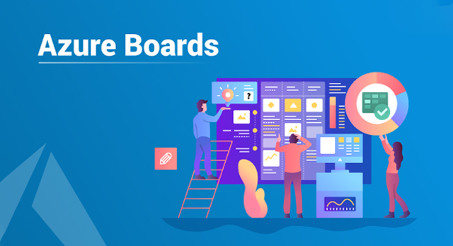
Azure Boards
“Azure boards is use to plan, track and discuss work across the team members and define updates and issues.”

Slide 25
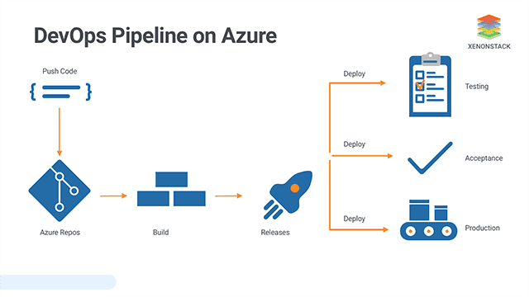
Azure Pipelines
“Azure Pipelines is a cloud service that combines the continous integration and continous delivery to test ,build and make it available to other user.”

Slide 26
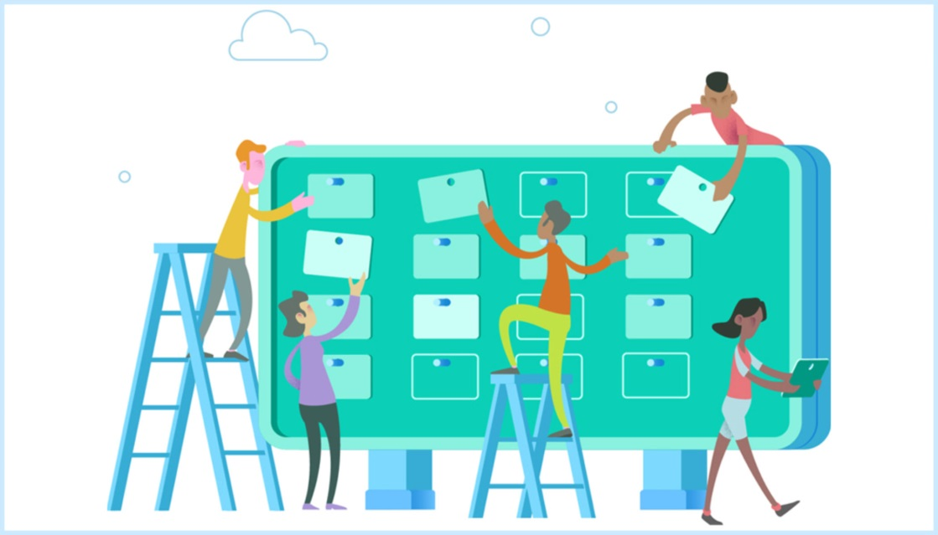
Azure Repose
“Azure Repose is a set of version control that one can use for managing code. It also provides free private repositories and code collaboration in the cloud.”

Slide 27
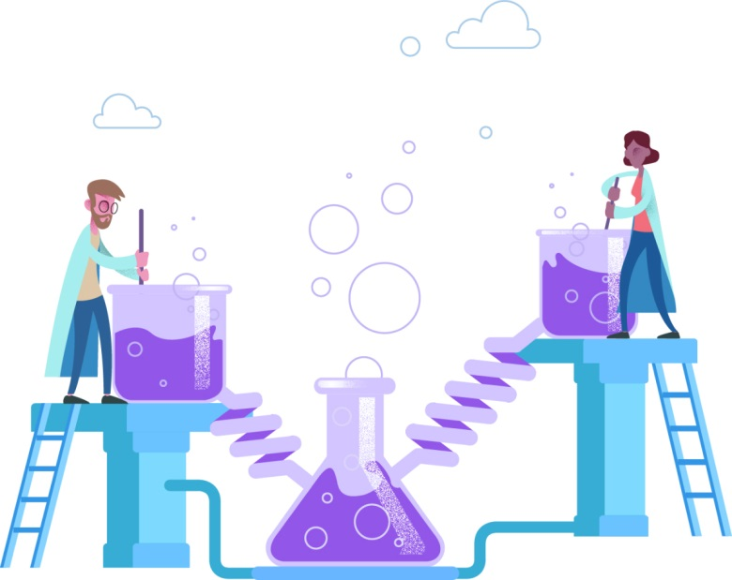
Azure Test plans
“An Azure Test plans improves the overall code quality by using manual and exploratory testing services.”

Slide 28
Azure for ML
Rapidly build and deploy machine learning models using tools that meet your needs regardless of skill level.
Empower developers and data scientists with a wide range of productive experiences for building, training and deploying machine learning models faster.
Use the no-code designer to get started or use built-in Jupyter notebooks for a code-first experience.
Accelarate model creation with the automated machine learning UI and access built-in feature engineering, algorithm selection and hyper parameter sweeping to develop highly accurate models.
Accelerate time to market and foster team collaboration with industry - leading MLOps- DevOps for machine learning.
MLOps or DevOps for machine learning, streamlines the machine learning lifecycle, from building models to deployment and management.
Innovate on a secure, trusted platform, designed for responsible ML.

Slide 29
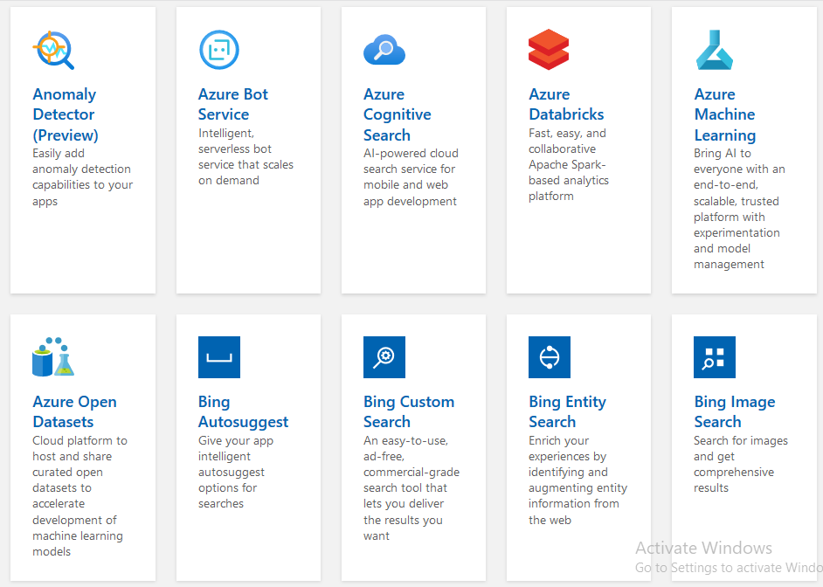

Slide 30
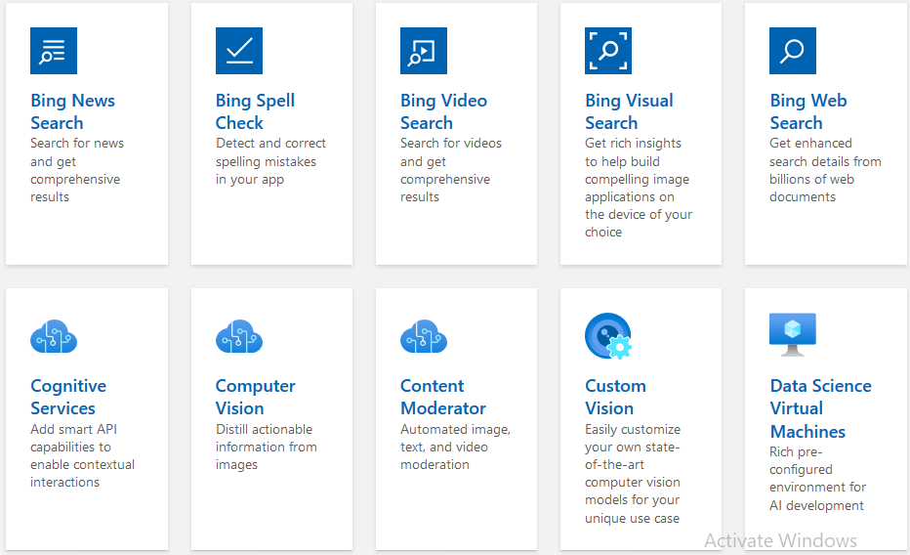

Slide 31
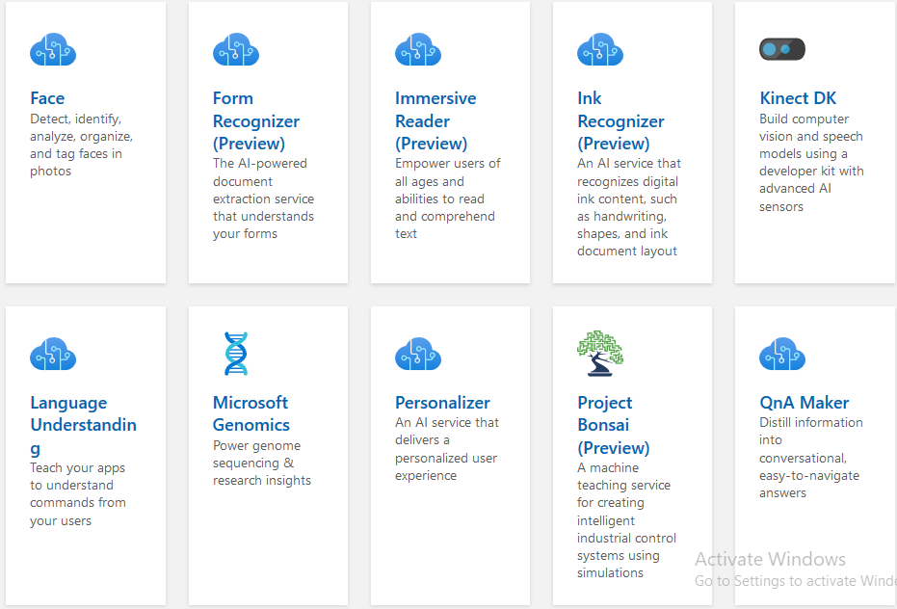

Slide 32
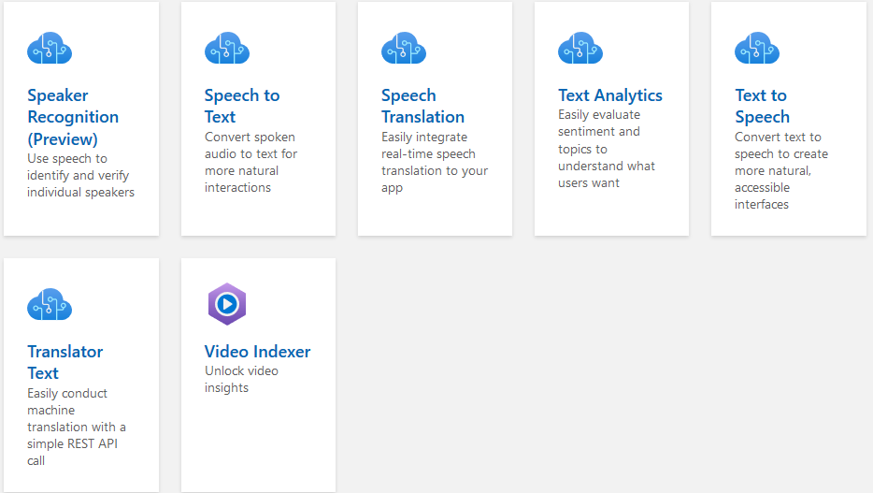

Slide 33
Azure for IoT
Security - enhanced communication channel for sending and receiving data from IoT devices
Using Azure Build your IoT application with two-way communication
Built-in device management and provisioning to connect and manage IoT devices at scale
Enable highly secure and reliable communication between your IoT application and the devices it manages. Azure IoT Hub provides a cloud-hosted solution backend to connect virtually any device.
Full integration with Event Grid and server less compute, simplifying IoT application development
Extend your solution from the cloud to the edge with per-device authentication, built-in device management and scaled provisioning.
Compatibility with Azure IoT Edge for building hybrid IoT applications

Slide 34
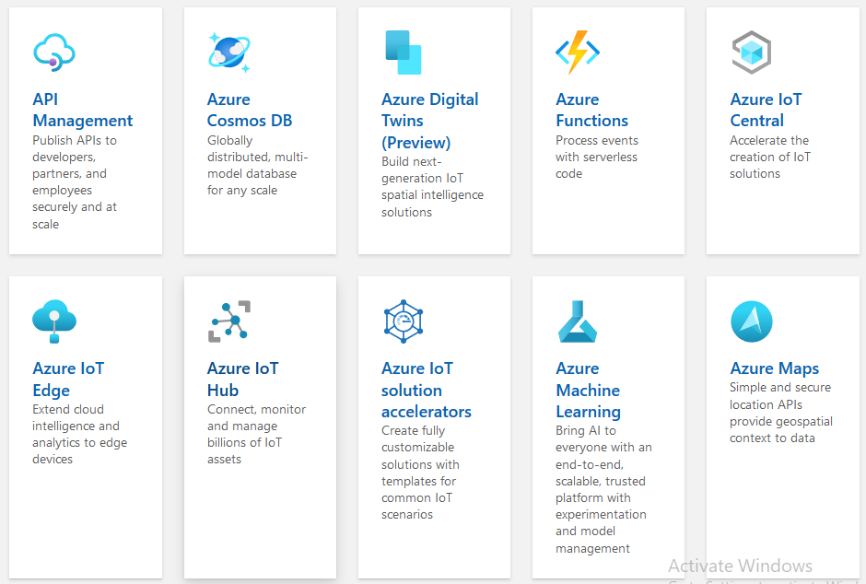

Slide 35
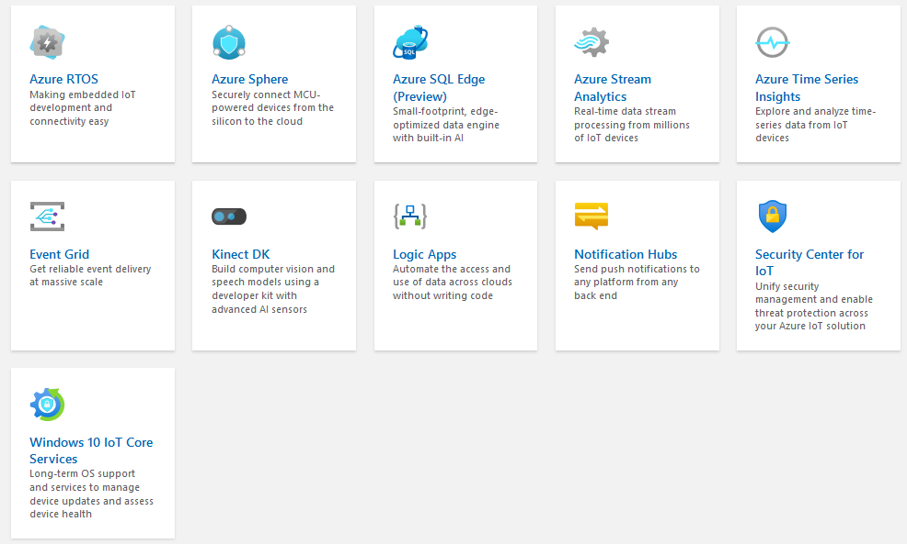

Slide 36
Why should you chose Azure?
2) Security : One of the most frequently cited obstacles to adopting cloud computing is security. Passing all your data to a separate provider and trusting them to ensure it remains safe is a big issue. However, if you are ever going to truly utilise the full benefits of cloud computing, then you need to trust the cloud provider you are using. And companies rarely come more secure than Microsoft.
1) Familiarity : It might be a little trite to suggest that you make a major financial decision based on simple familiarity, but it really is an important aspect. If you’ve ever used a PC then you are already familiar with the way Microsoft works. Azure is based heavily on Windows and since 1995 Windows has been the most popular operating system in use.
3) Scalability : One of the overall benefits to using cloud computing is that it offers scalability, but just like in everything else they do, Microsoft like to go a step further than pretty much everyone else. When it comes to Microsoft Azure and scalability there are a number of things worth mentioning.
Azure scalability goes so much further than just reacting to website traffic and increasing your bandwidth in response to demand. They take this principle and apply it to all the various services you can use.
4) Software Development Kits : It’s safe to say that if you are looking to make the very most of Microsoft Azure then you will likely be developing your own applications to one degree or another and there is no place better for this than within Azure. Whether you are using .NET, Java, PHP, Python, Ruby, or any of a large number of languages then Microsoft Azure has a SDK for you whatever your platform of choice is.

Slide 37
5) Cognitive Services : Everyone knows that AI is going to play a huge role in the future of digital, but no-one seems to be completely certain how that is going to happen. No-one except Microsoft. There is Cognitive Services Lab where new AI services are being developed. Here you can become part of a team testing and helping refine cognitive services for Azure before the become market ready.
6) Managed Azure : Even now, well over a thousand words in, we have only begun to scratch the surface of what Microsoft Azure is capable of, and how it can impact your business in a tangible and realistic manner. It is a hugely complex and detailed service, which when applied properly can revolutionise your site and your business. However setting up and managing Azure can be a complex undertaking, and this can put many people off doing so.
7) Cost Efficient Platform : Microsoft’s pay-as-you-go model allows you to pay for what you use to build or expand resources using Azure services. This cuts down the IT administration costs to a minimum as infrastructure is taken care by Microsoft on Azure. It connects data centers to the cloud effortlessly and supports 42 regions like no other cloud provider.

Slide 38
Thank
You
For more info you can refer to:
https://docs.microsoft.com/en-us/azure/?product=featured

Slide 39
Presented By:
Kumar Saurav
Harshita
Aman Yadav
Zahra Saktiwala

